Slide 1

Stable Language Variation in the Age of AI
Laura A. Janda
laura.janda@uit.no
with: Tore Nesset, Yuliia Palii, Reza Soltani

Slide 2

The one that got away…
A grant proposal submitted to the Norwegian Research Council
Missed funding by 1 point
My university gave me a postdoc position as a “consolation prize”

Slide 3
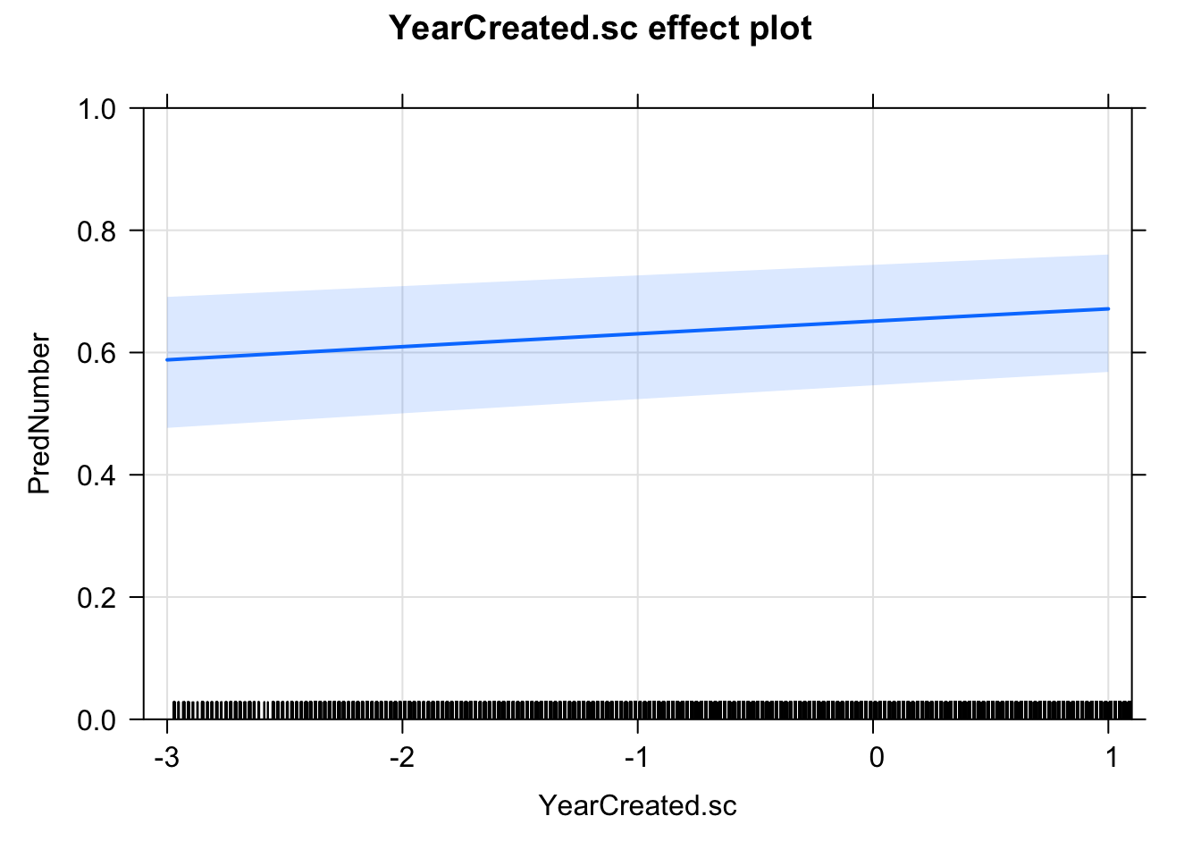
How I got interested in this topic
Y-axis is probability of PL
Nesset & Janda (2023) found that Singular (44%) vs. Plural (56%) variation in verbs with quantified subjects in Russian (e.g. ostalos’[sg]/ostalis’[pl] šest’ čelovek ‘six people remained’) has persisted nearly unchanged over the past 200 years
1800
2017
Surprising because Russian numeral morphosyntax has otherwise changed radically

Slide 4
The idea
Can LLMs impact the pace and direction of change?
The environment
Stable co-existence of variant forms in language is common, though often overlooked
Preponderance of machine-generated language
The issues
Do LLMs reproduce stable variation, or do they exaggerate biases?
If LLMs exaggerate biases, can they propel language change?
The material
Singular vs. Plural variation across 5 languages
Corpus data, experiments with humans and LLMs

Slide 5
Overview
State of the Art
Hypothesis and Research Questions
Team and Collaborators
Note that both Norwegian Research Council and European Research Council follow template:
1. Excellence, 2. Impact, 3. Implementation

Slide 6
State of the Art

Slide 7
State of the Art
Languages
Language variation, language change, and stability
Singular vs. Plural (SvP) variation
Cognitive multistability
LLMs and chatbots
Preponderance of machine-generated language
How LLMs work
Human-machine interaction
Pilot studies of SvP variation

Slide 8
Language variation
When linguists look at variation, they tend to focus more on change than on stability
Exceptions: Longobardi 2001, Friðriksson 2008, Keenan 2009
Linguists tend to assume that variation must carry sociolinguistic indexical value (Weinreich et al. 1968, Milroy 1992, Croft 2000, Blythe & Croft 2012)
Exceptions: Lass 1997, Ajión-Oliva and Serrano 2013

Slide 9
Language change
Various facts and assumptions:
“Differential weighting”
S-curves
Spread of change
Locus and quality of change

Slide 10
Blythe, W., Croft, W. 2012. S-curves and the mechanisms of propagation in language change. Language 88: 2, 2012, 269-304. 39 studies of variation leading to change, plus computer simulations
The S-curves are driven by “differential weighting” (cf. Croft 2000 & Labov 2001) “For whatever reason, a speaker or group of speakers weights the language use of other (groups of) speakers differentially. That speaker/group then observes that a particular variant is probabilistically associated with the relevant speaker/group, and transfers the weighting from the speaker/group to the variant.”

Slide 11
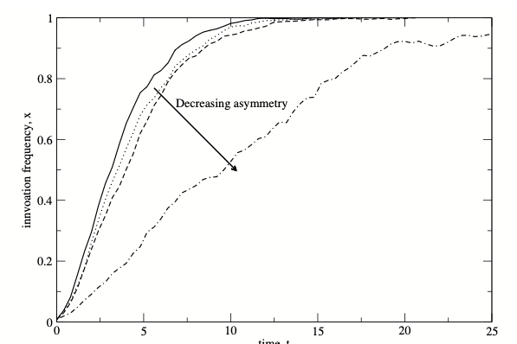
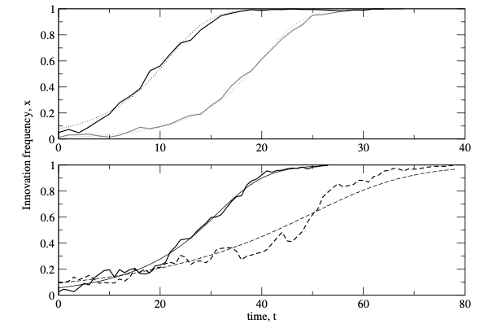
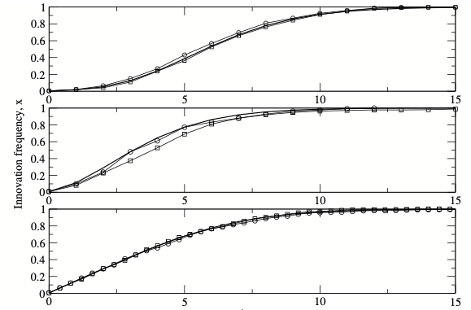
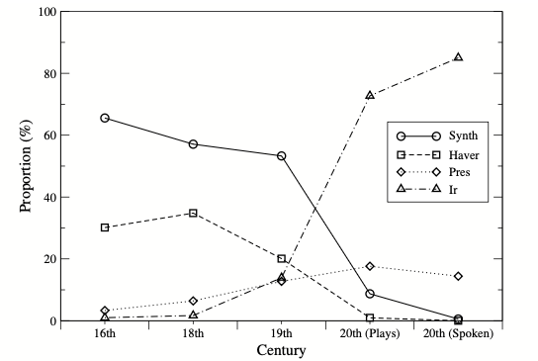
Blythe, W., Croft, W. 2012. S-curves and the mechanisms of propagation in language change. Language 88: 2, 2012, 269-304. 39 studies of variation leading to change, plus computer simulations

Slide 12

Spread of change
The spread of language change (“transition” cf. Weinreich et al. 1968) is facilitated by the presence of “numerous weak [social] ties”, in particular “first-order ties” realized as direct linguistic interactions (Milroy 1992, 2002) that can propagate change across a speech community.
In other words: language change spreads when lots of people talk to one another

Slide 13
Locus and quality of change
Some have assumed that language change takes place at L1 acquisition (Andersen 1973 & 1989)
Some have assumed that language change is categorical
Others show evidence that language change takes place across the lifespan (Mechler & Buchstaller 2019)
Others show evidence that language change is gradual (Bybee & Beckner 2015)
If the “others” are right, adults are liable to make gradual changes in language based on their exposure to interactional use of language.

Slide 14
Singular vs. Plural (SvP) variation
Corbett (2000) describes number as at once deceptively simple, yet “the most underestimated of grammatical categories”, presenting complex facts that differ across languages.
Grammatical number is the context for many types of variation, such as syntactic Singular agreement motivated by a Singular noun vs. semantic Plural agreement motivated by the fact that the noun refers to a multitude of individuals. This tug-of-war between syntax and semantics lies at the heart of controversies about grammatical agreement (Corbett 2006, Kibrik 2019).

Slide 15
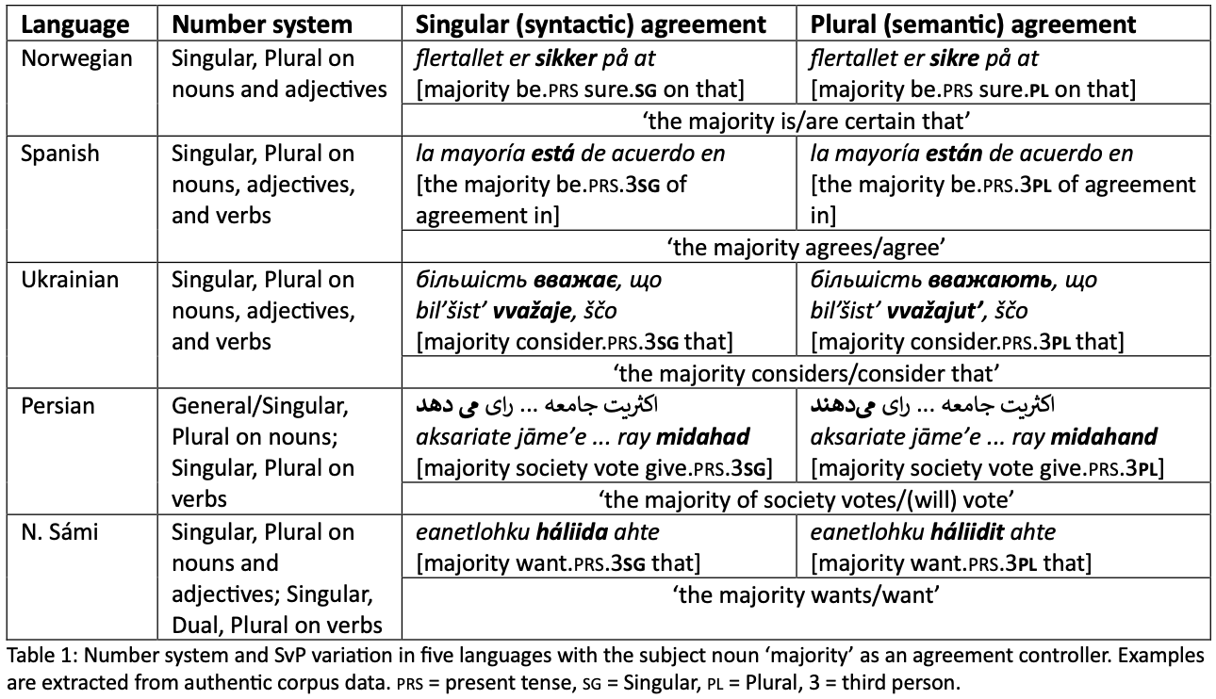
Germanic
Romance
Four major branches of Indo-European
Slavic
Indo-Iranian
Uralic indigenous minority language

Slide 17
SvP variation in those 5 languages
Norwegian. Corpus data: 33% PL, ranging from 9% for regjering ‘government’ to 85% for the Rosenborg soccer team. Factors: distance, type of noun, type of adjective. (Nesset 2022 et al., experimental data forthcoming)
Spanish. Riveiro Outeiral & Acuña-Fariña (2012) tested 3 kinds of sentences: 1) postmodified subjects una banda de matones ‘a gang of thugs’, 2) copular verb la causa del accidente + (ser) + los frenos ‘the cause of the accident (BE) the brakes’, 3) pseudoclefts lo que a mí realmente me gusta + (ser) + Plural noun ‘the thing I really like (BE)’. Factors: distance, construction type, word order.

Slide 18
SvP variation in those 5 languages
Persian. Hashabeiky (2007) finds SvP variation with no evidence of language change across 24 centuries. Experiments with Persian speakers (Feizmohammadpour 2013) reveal that SvP agreement in construction with PL inanimate subjects is influenced by semantic factors such as construal of the subject noun as individualized or patient-like.
North Sámi. Quantified nouns are SG and usually agree with PL verb forms, though SG is possible (Nickel & Sammallahti 2011). SvP variation also with mathematical operations and conjoined subjects, where verb tends to agree with the closest NP.

Slide 19
Subitizing

Slide 20
Subitizing (cited from Wikipedia)
Subitizing is the rapid, accurate, and effortless ability to perceive small quantities of items in a set, typically when there are four or fewer items, without relying on linguistic or arithmetic processes. The term refers to the sensation of instantly knowing how many objects are in the visual scene when their number falls within the subitizing range.
The term subitizing was coined in 1949 by E. L. Kaufman et al., and is derived from the Latin adjective subitus (meaning "sudden").

Slide 21
How many RED circles?
How many BLUE circles?

Slide 22
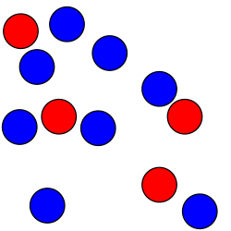
How many RED circles?
How many BLUE circles?

Slide 23
How many RED circles?
How many BLUE circles?

Slide 24
Plurals and Masses in English grammar
Johnson (1987: 26) the same group of objects can be construed both as a mass and as a number of individuals
Lakoff (1987: 427–428) and Langacker (2008: 130–140):
masses portrayed as “non-plural mass” (sand) vs. “plural mass” (cats)
(1) all/most sand/cats/*cat
(2) They’re looking for *cat/sand/cats.
(3) a cat/*sand/*cats
(4) those/these/many/few/several/numerous cats vs. that/this/much/little sand
(5) three cats/*sand
Mass and Plural behave the same way

Slide 25
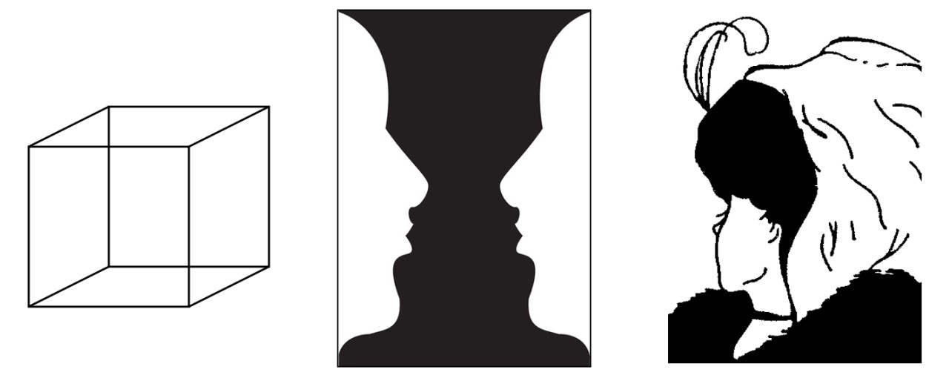
Alternative construals of masses / multitudes
cf. Langacker (2008: 131), Johnson (1987: 26)
Singular
Plural
Cognitive multistability
(Stadler & Kruse 1995),
like ambiguous images

Slide 26
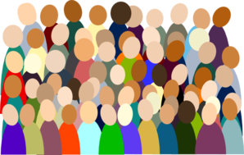
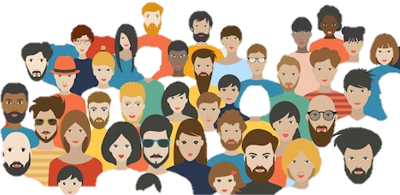
багато людей...
прийшло (SG)
прийшли (PL)
Ukrainian ‘A lot of people came’

Slide 27

My colleague in the Computer Science Department at UiT, Dilip Prasad
“Laura, most of what’s on the internet is not going to be written by human beings.”
Thompson et al. (2024) estimate that a “shocking” 57.1% of texts on the Internet are machine-generated, a growing trend, particularly for low-resource languages targeted by multi-way machine translations.

Slide 28
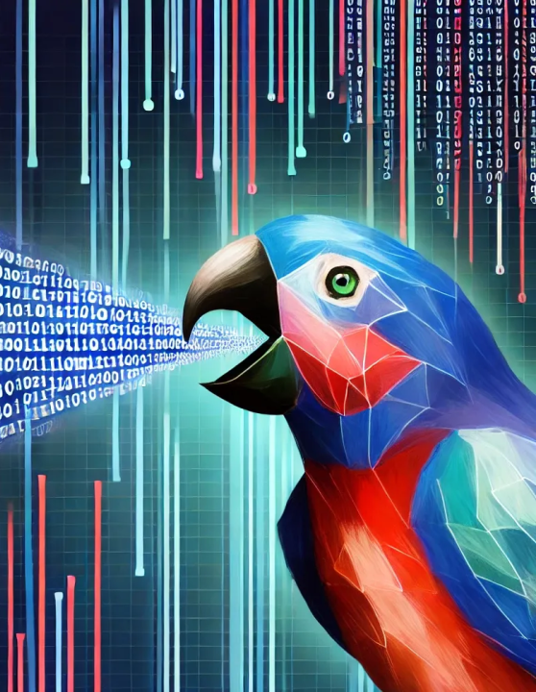
How LLMs work
An LLM tokenizes language into units and computes the probability of the next unit in a string
Bender et al. 2021 “On the Dangers of Stochastic Parrots”
LLMs tend to perpetuate and often exaggerate biases present in training data (Manning 2022)
BUT: no one has looked at grammatical bias in LLMs

Slide 29
Human-AI interaction on a massive scale
Millions (billions?) of people can converse with LLM-sourced chatbots on an unlimited and even intimate basis (cf. “numerous weak ties” and “first-order ties”)
We know that human beings are sensitive to frequency distributions in language (Bybee 2015)
Will LLMs serve the role of “sociolinguistic icons” (Eckert 2000) to which people accommodate their speech in a process of “koineization” (Kerswill 2002)?

Slide 30
Pilot studies (with GPT-3.5/4, 2024)
Ukrainian: 200 corpus sentences with bahato ‘many’ + NP subjects, verbs (100 SG/100 PL) removed. GPT replaced many SG verbs with PL, 86% with animates.
Persian: base rate in Modern Persian: over 80% of inanimate Plural subjects receive Singular marking on verbs (Hashabeiky 2007). We tested 1) -hā (default plural marker), e.g. xāne-hā ‘house-s’; 2) -ān (less common with inanimate nouns), e.g. gonāh-ān ‘sin-s’; 3) -āt (borrowed from Arabic), e.g. āzmāyeš-āt ‘test-s’; 4) irregular plurals (“broken plurals”), e.g. ’ātefeh, ’avātef ‘emotion, emotions’. For types 1 and 2, chatbots deviated to Plural across the board, whereas for types 3 and 4, they returned both Singular and Plural verb forms

Slide 31
Hypothesis and Research Questions

Slide 32
Hypothesis
The presence of variation minus any expectation of change, in combination with abundant direct linguistic interactions, yields optimal conditions for probing whether an external factor such as use of chatbots sourced from LLMs might spur language change by changing the frequency distribution of variants.

Slide 33
Hypothesis broken down
SvP variation, while differing in detail across languages, serves a subtle function by facilitating cognitive multistability, and is normally maintained by human speakers.
Corpus and experimental data should by and large correspond, though there may be differences: for example, in experiments people might show higher than expected production and acceptability of low-frequent variants.
LLMs might exaggerate preference for high-frequent variants, potentially tipping the scale toward language change.
It may be possible to discover an optimal temperature for LLMs, such that they reflect variation without exaggeration.

Slide 34
Research Question 1
What does human-generated corpus data reveal about SvP variation and its stability?
Native speaker-linguists will identify relevant grammatical constructions. Corpus queries will yield data that will be annotated for factors such as animacy, word order, and distance (number of intervening words between controller and target). Factors will be evaluated via multivariate statistical analyses such as mixed-effects regression (Baayen 2008, Gries 2021) and linear discriminative learning (Chuang et al. 2023).

Slide 35
Research Question 2
How do speakers react to and produce SvP variation?
Native speakers will be tested for reaction time to Singular and Plural variants via eye-tracking, asked to rate the acceptability of variants, and given cloze passage (fill in the blank) tasks targeting those variants. Web-based and in-person experiments will be designed, piloted, and carried out by recruiting 100 native speakers per language in Norway, Ukraine, and Iran.

Slide 36
Research Question 3
How do LLMs reflect SvP variation?
LLMs will be probed for responses to stimuli parallel to those gleaned from corpora and used in experiments with human beings, querying both for ratings of acceptability and for cloze passage completion. LLMs will also be given prompts to generate texts on topics likely to produce examples relevant to SvP variation in order to provide data comparable to corpora. The choice of languages is important to gauge the capacity of LLMs to represent other languages in the face of the dominance of English data. Tests will be conducted across various temperatures.

Slide 37
Research Question 4
How does human vs. LLM behavior compare in the context of SvP variation?
Data will be analyzed statistically to discover to what extent: a) the human corpus and experimental data correspond to each other and b) the LLM data conforms to the human data.

Slide 38
Team and Collaborators

Slide 39

Research group at UiT:
Laura Janda (all 5 languages, but not a native speaker)
Tore Nesset (Norwegian)
Yuliia Palii (Ukrainian)
Reza Soltani (Persian)

Slide 40

UiT’s indigenous language technology research group:
Lene Antonsen (North Sámi)

Slide 41
UiT’s Center for Language, Brain and Learning (C-LaBL):
Natalia Mitrofanova (psycholinguistic experimentation)

Slide 42

UiT’s Bio-AI Lab and Department of Computer Science:
Dilip Prasad (LLMs and AI tools)

Slide 43

Norwegian University of Science and Technology:
Antonio Fábregas (Spanish)

